Slide 1

Employee Management System
In C Language
Presented By
Prasoon Varshney
Employee ID : 201188
AES ENSEMBLE
Presented to
Sachin Vasav

Slide 2
AGENDA
Defining the Structure 3
The Starting Point 4
Accept Employee 5
The Main Logic 7
Output 8

Slide 3
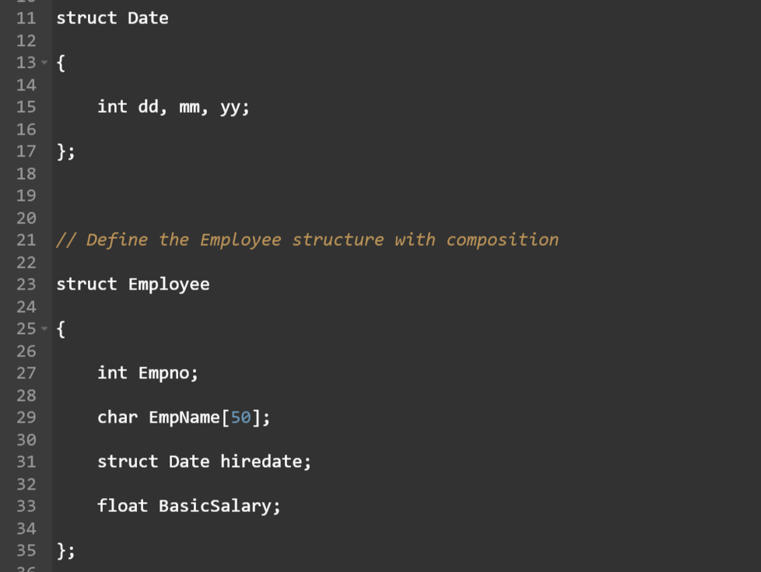
Defining the Structure

Slide 4
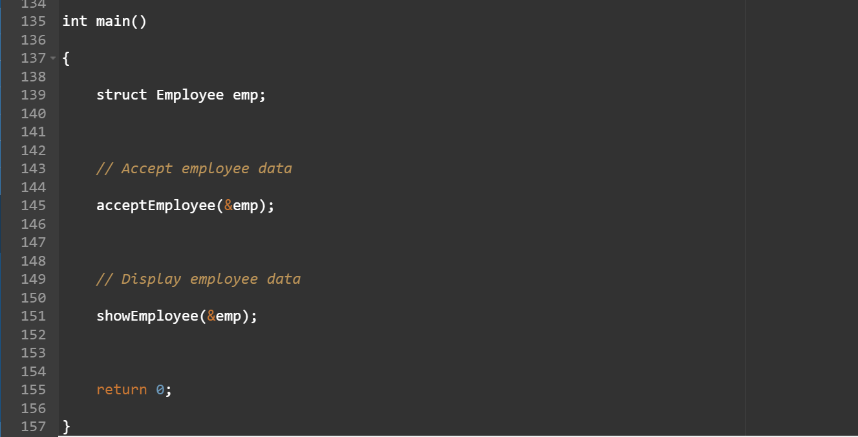
The Starting Point

Slide 5
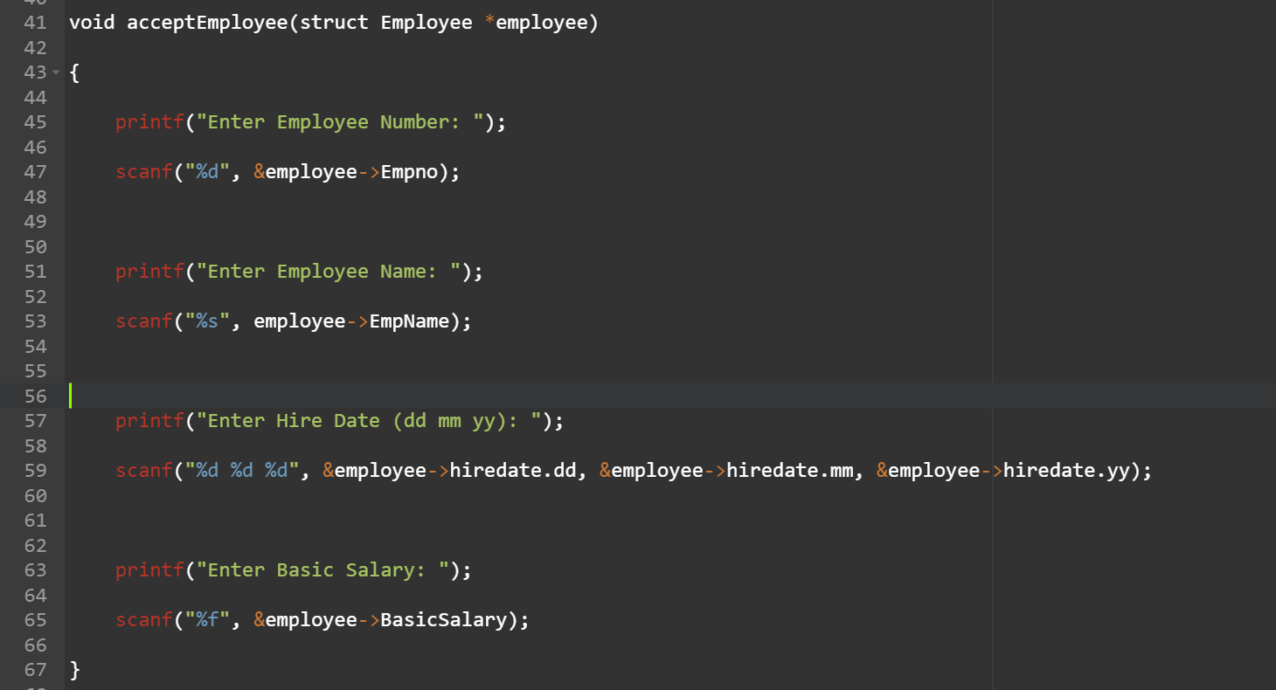
Accept Employee

Slide 6
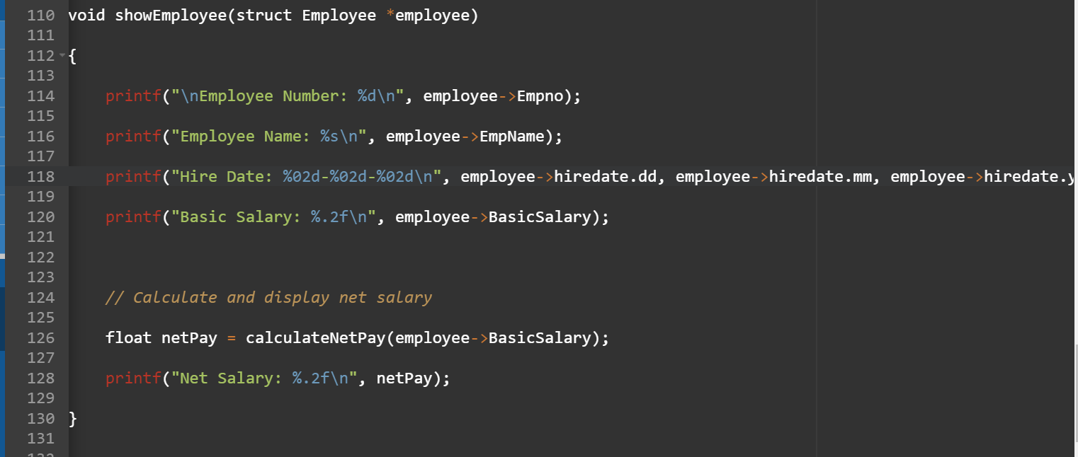
Show Employee

Slide 7
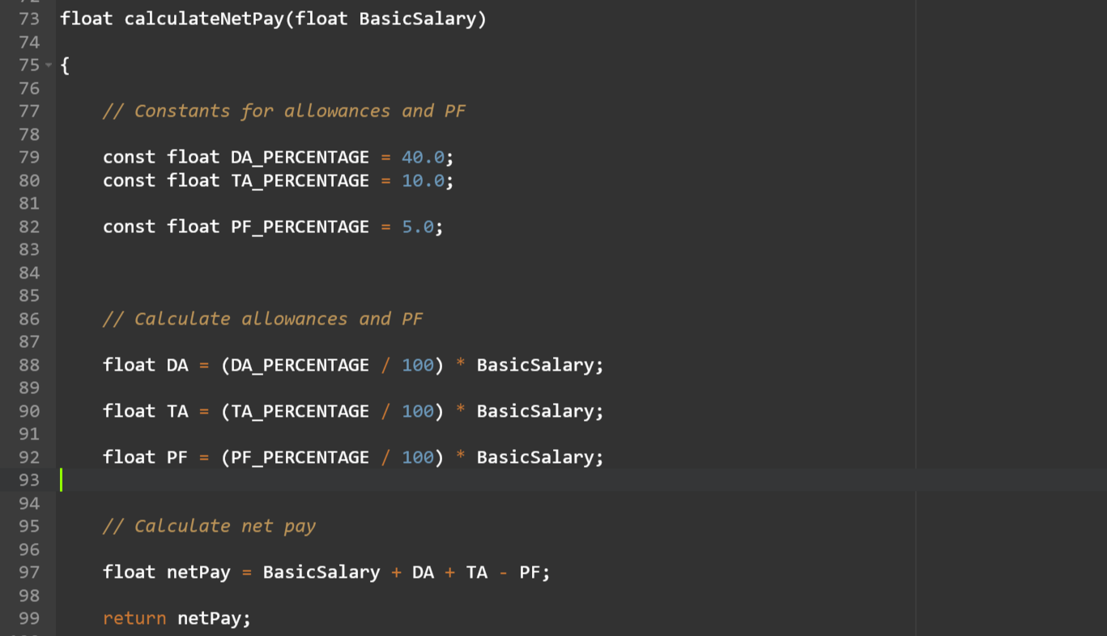
The Main Logic

Slide 8
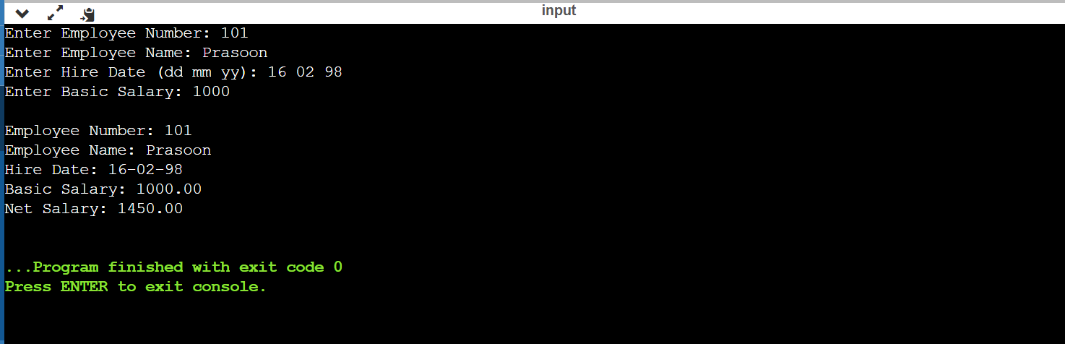
Output

Slide 9
Thank You!

